Slide 1
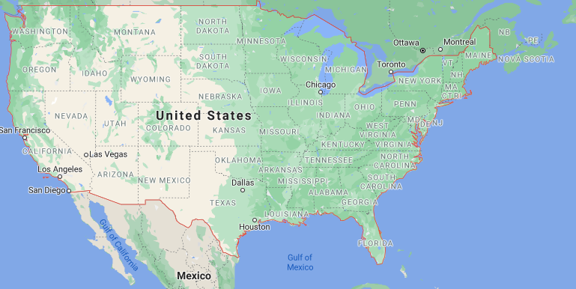
Weather Conditions - view 1
Filters
Geographic Location
Weather Type
Severity
Filters
Duration/Date

Slide 2
Weather events - view 2
Filters
Weather Count
Type
Filters
Duration/Date

Slide 3
Flight delays - view 3
Filters
Airports
Weather Type
Severity
Flight delays
Flight Cancelled
Filters
Duration/Date

